Slide 1
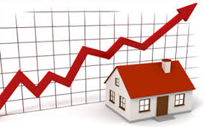
Real Estate Market Analysis
by
Group1

Slide 2
Contents
Data Collection
Data Cleaning
Exploratory Data Analysis
Predictive Analysis

Slide 3








Tools and Packages

Slide 4

Data Collection

Slide 5

Data Source
Redfin is a Seattle-based real estate brokerage company that offers online real estate services to homebuyers and sellers. Their data includes information on address attributes, house attributes, and price attributes.

Slide 6
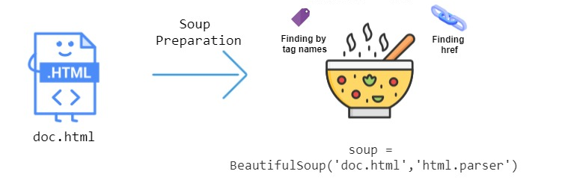
HTML PARSER
An HTML parser is a program that converts HTML code into a structured format. It is commonly used in web development and data extraction to parse web pages and extract specific information.

Slide 7
Data Collection Steps
Define empty lists to store scraped data.
Loop through each county's property URLs and scrape data for each property.
For each property:
Send a request to the URL and parse the HTML content using BeautifulSoup.
Extract various information about each property from the HTML content using BeautifulSoup and append to the appropriate empty list.
Combine the data from the lists into a pandas DataFrame.
Save the DataFrame as a CSV file named "rawdata_project.csv".

Slide 8

Data Cleaning
Counted the number of missing rows with no beds and baths and printed the result.
Dropped all properties with empty land (no beds and baths).
Filled missing values for 'Beds_list', 'Baths_list', and 'Bike_Score_list' columns with 0.
Counted the number of missing values for each column in the DataFrame and printed the result.
Dropped all rows with missing values in the 'Square_Footage_list' and 'State_list' columns.
Removed special characters from the 'Price_list' column and converted it to float data type.
Removed special characters from the 'School_Rating_list' column and converted it to int data type. Filled missing values in the column with 0.
Converted the 'Year_Built_list' column to int data type and filled missing values in the column with 0.

Slide 9
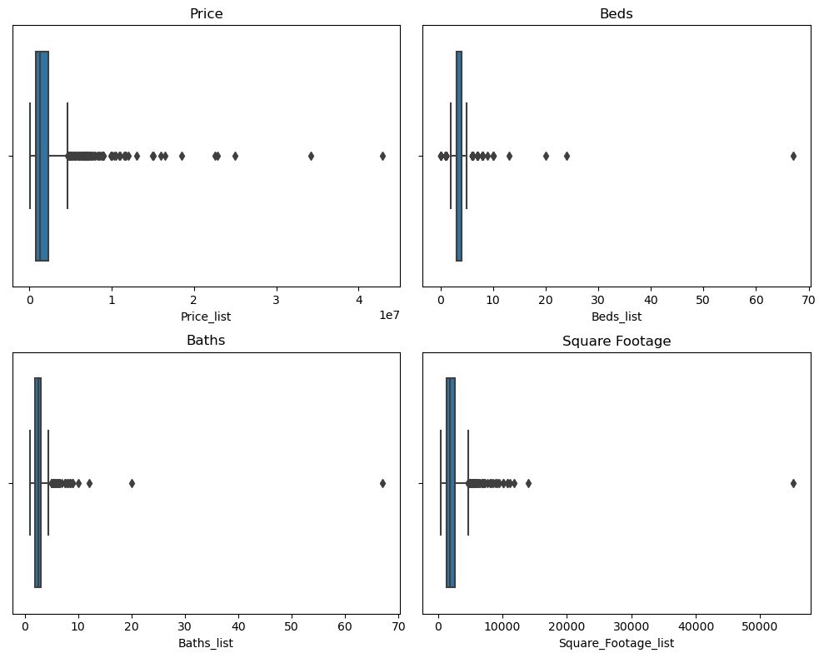
OUTLIERS

Slide 10
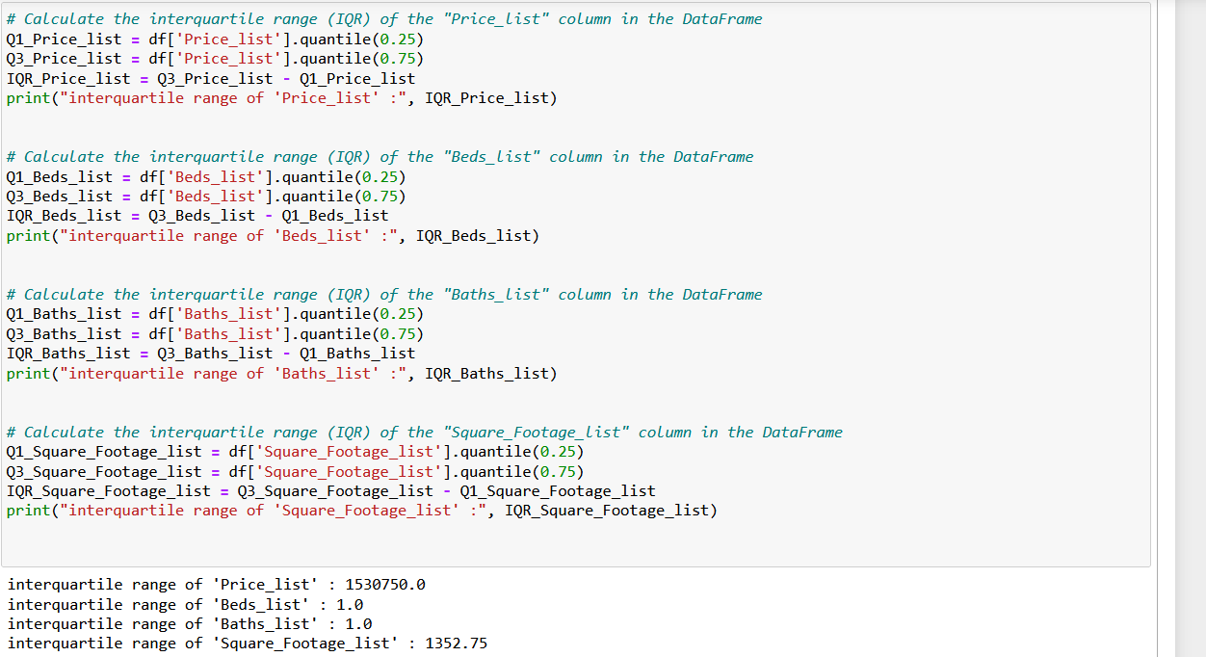
Calculating the Interquartile Range (IQR)

Slide 11
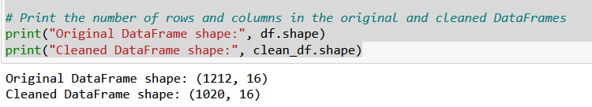
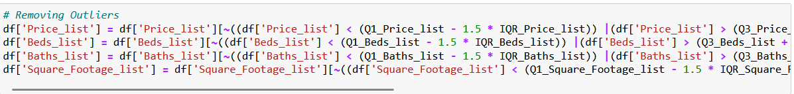
Removal of Ouliers

Slide 12
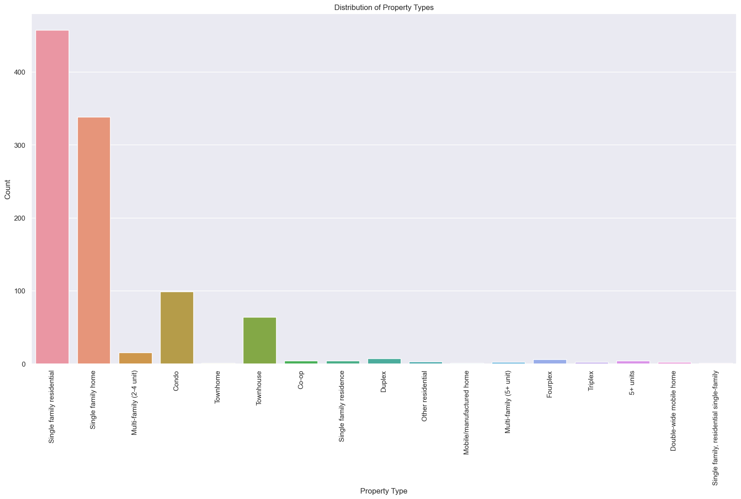
Data Analysis – Property type

Slide 13
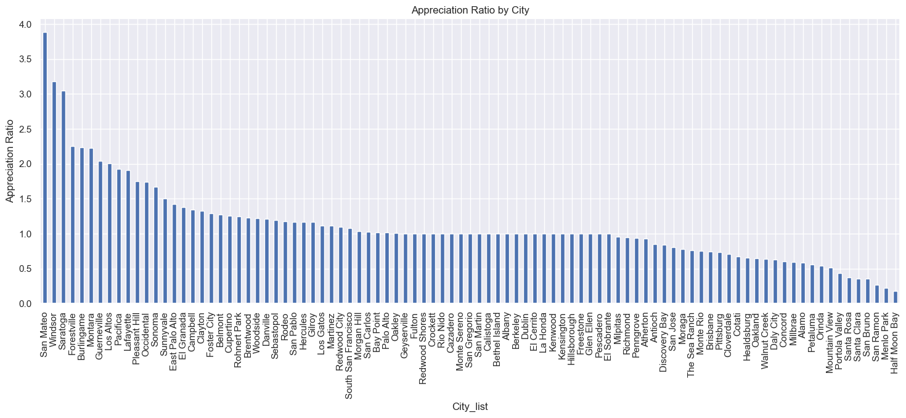
Data Analysis – Appreciation Ratio by City

Slide 14
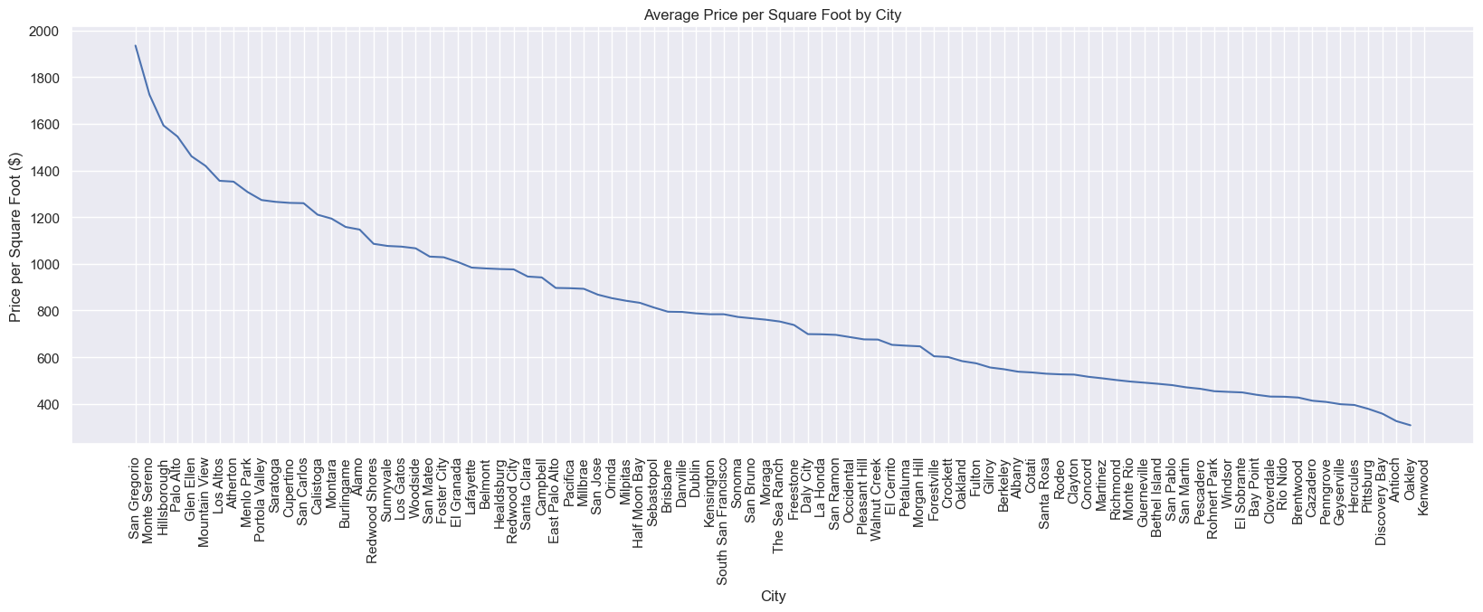
Data Analysis – City

Slide 15
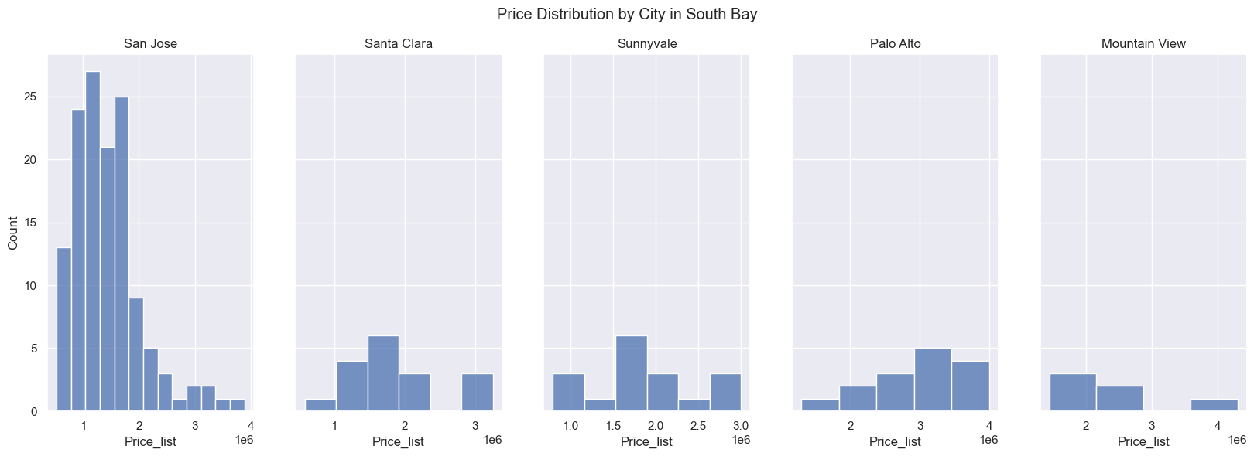
Data Analysis – City in South Bay
San Jose has relatively more properties among these South Bay cities, and most of properties in SJ are in price level of 1 to 2, which is similar to Santa Clare.
Properties in Palo Alto tend to have higher price, mostly in the level 3-4 of price list.

Slide 16
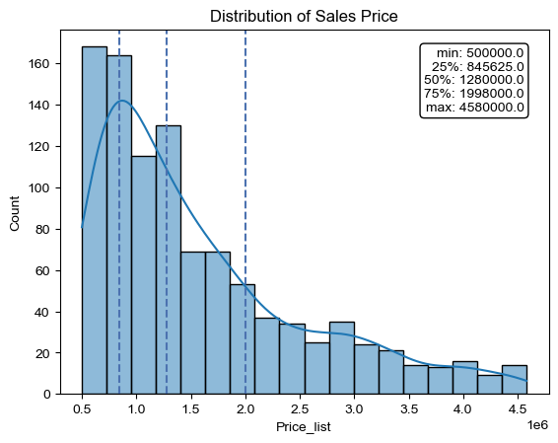
Data Analysis – Price Distribution
Due to the summary of the data, threshold the data at $500,000 to avoid any possible scams considering the median price of the property prices as $700,000
And we use histogram to visualize the distribution of sales price.
According to the graph, there are more properties in lower price range. Particularly between the minimum price list to the median price list.
However, there seems to have less properties in the price range of 1,000,000 to 1,200,000.

Slide 17
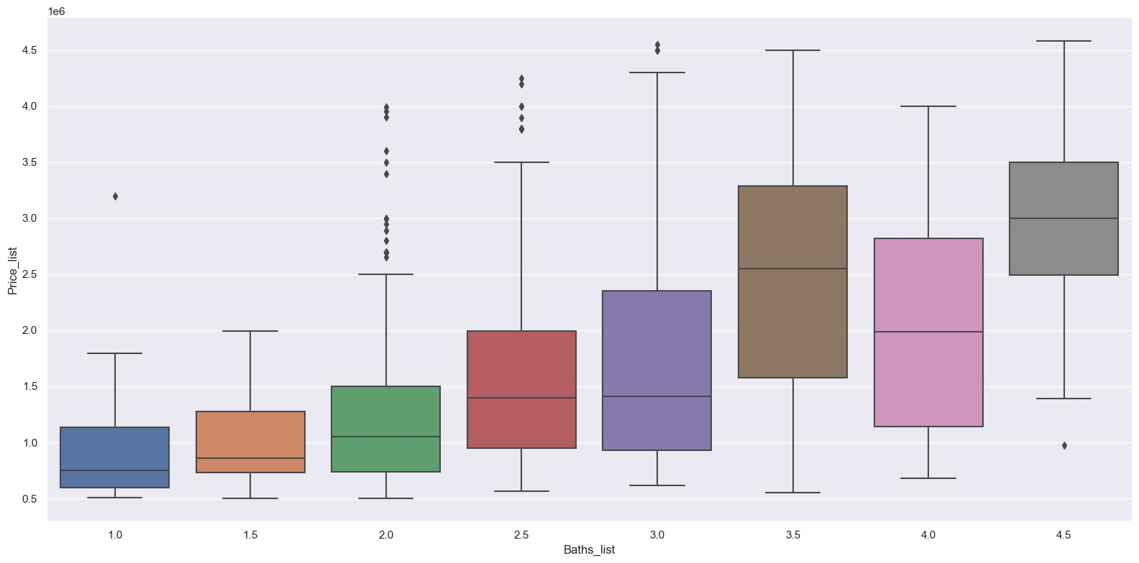
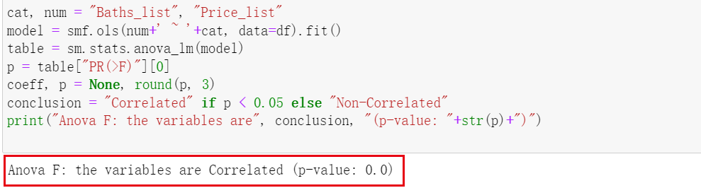
Data Analysis – Bath & Price
To study the relationship between number of baths and price, we used cat plot.
The plot illustrates that as the number of baths increases, the price increases. This also suggests that the house with 3.5 and 4.5 baths sell at higher prices.
So we use a Anova table to get the p-value of the relationship, which turns out to be 0, suggesting that this two variables are correlated with each other.

Slide 18
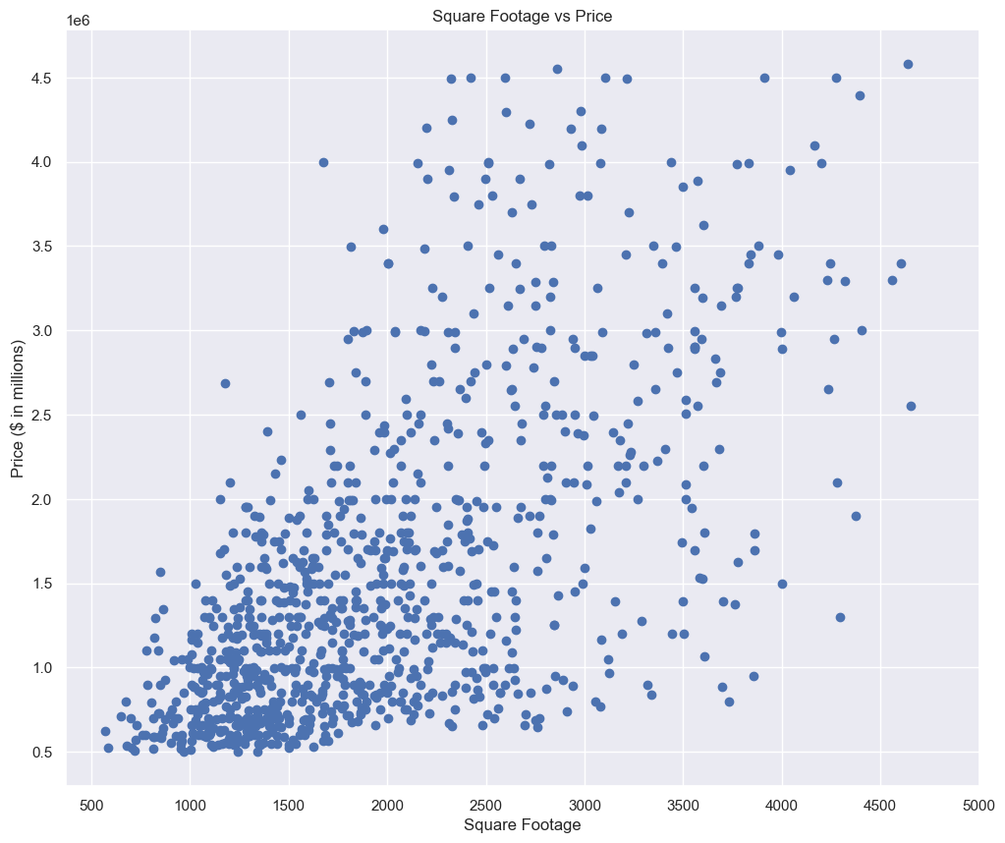
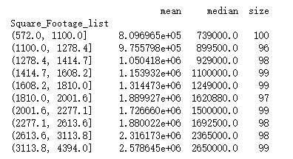
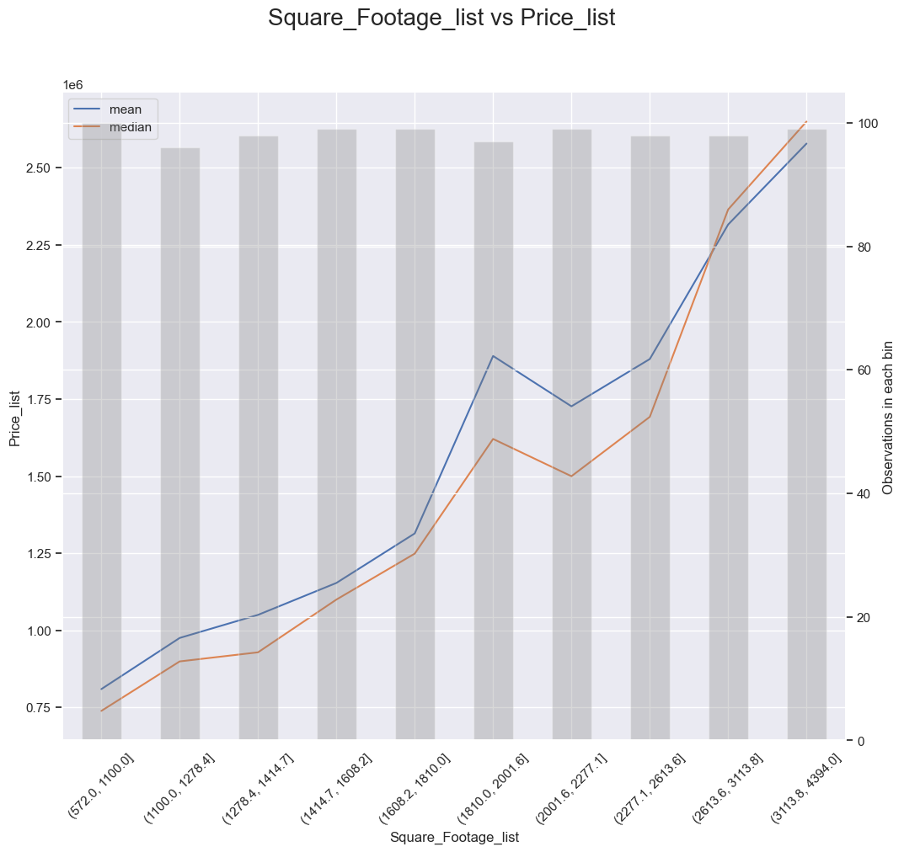
Data Analysis – Square Footage & Price
Then we used a bin plot to show their relationship. The graph has a positive correlation, meaning that as the square footage of the house increases, the price of the house also increases.
The graph also shows that there is a threshold value of square footage at which the price of the house starts to increase significantly. This threshold value is around 1,200 square feet, after which the price of the house increases rapidly.
We first generated a table to analyze the ranges of square footage for a set of real estate properties.
And the table shows that, in general, the mean and median prices tend to increase as the square footage of the property increases. The largest properties, in the 3113.8 to 4394.0 square footage range, have the highest mean and median prices.

Slide 19
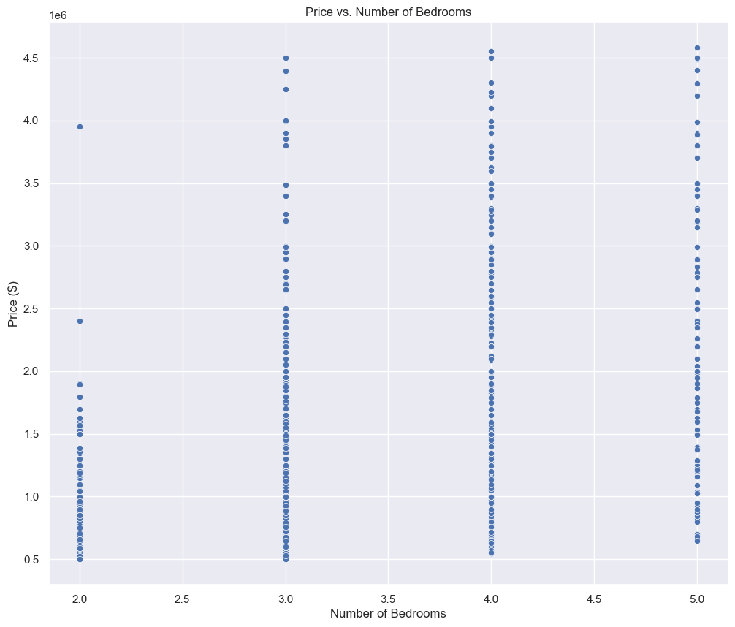
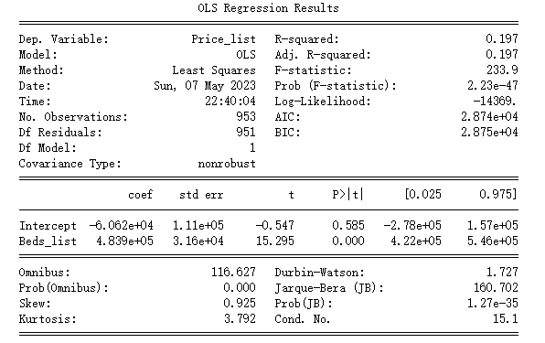
Data Analysis – Bedroom & Price
The plot has a positive correlation, meaning that as the number of bedrooms in a house increases, the price of the house also increases.
The plot also shows that there is a significant amount of variation in the data, with some houses having more bedrooms than others and some having higher prices than others. This variation suggests that other factors, such as location and amenities, may also be important in determining the price of a house.
The R-squared value is 0.197, which indicates that about 19.7% of the variation in the dependent variable is explained by the independent variable. The F-statistic value is 233.9, and the associated p-value is 2.23e-47, which means that the overall model is statistically significant.
In addition, the p-value associated with the Beds_list coefficient is 0, which also means that the coefficient is statistically significant.

Slide 20
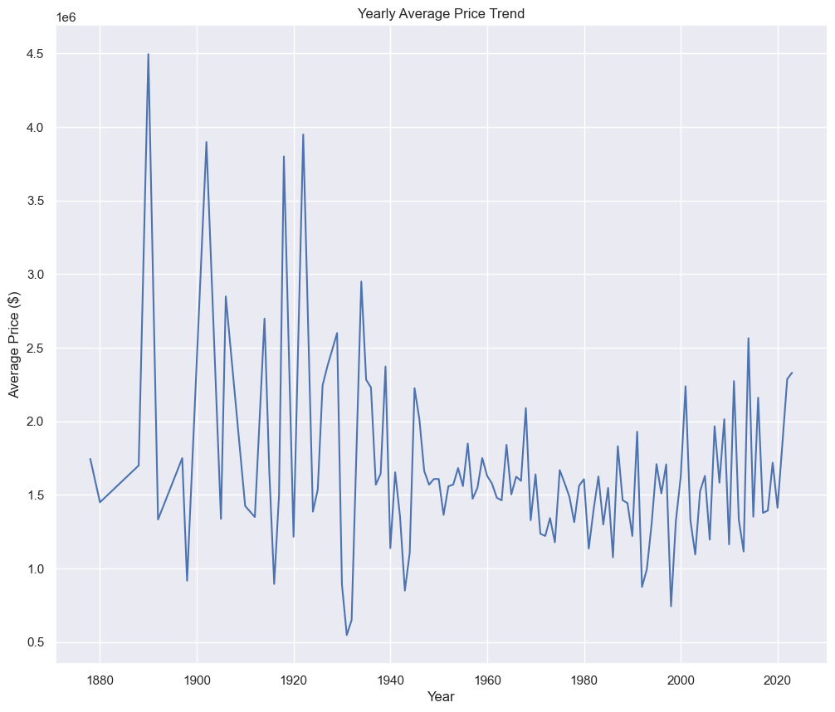
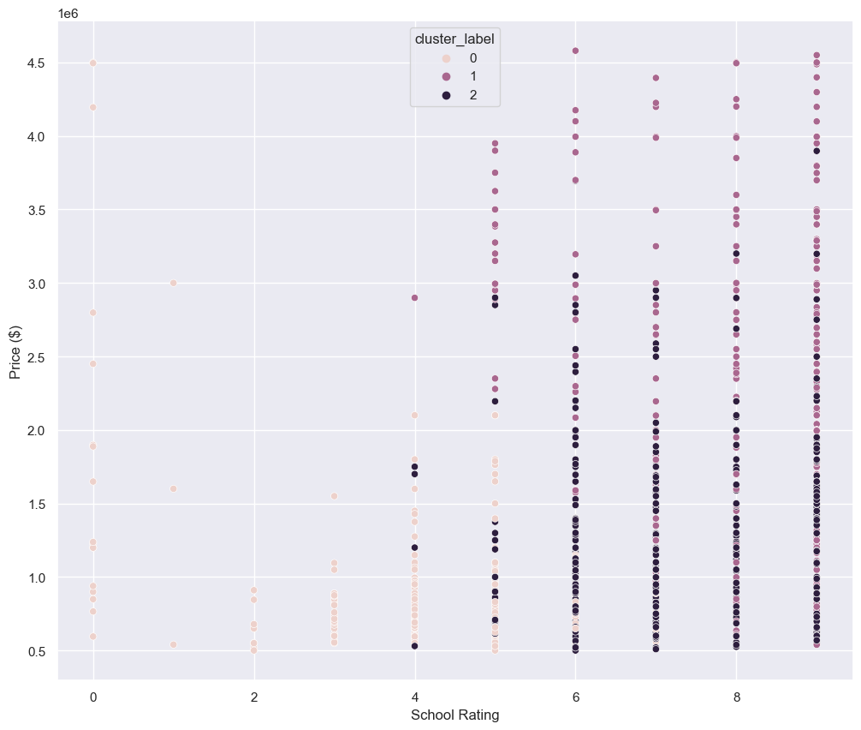
Data Analysis –Year Price Trend & School Rating
We can see that after year 1940, the line becomes relatively flat, which indicates that the average price has remained relatively constant during 1940 to 2020.
Both the highest and lowest avg prices appears before 1940.
The plot shows that as the school rating increases, the house price also increases, but at a slower rate.
The plot also shows that there is a correlation between the two variables, with the house price increasing as the school rating.

Slide 21
Pre-Processing Steps
A heatmap is plotted to visualize the Pearson correlation between the numerical columns in the dataframe.
The Z-scores of the numerical columns are calculated and entries with outlier values are filtered out.
Boxplots are created to visualize the distribution of the numerical columns and identify any remaining outliers.
The categorical columns are one-hot encoded using ColumnTransformer and the numeric columns are selected as predictor variables for machine learning models.
Feature importance is calculated using the GradientBoostingRegressor model and plotted in a bar chart and cumulative line chart.

Slide 22
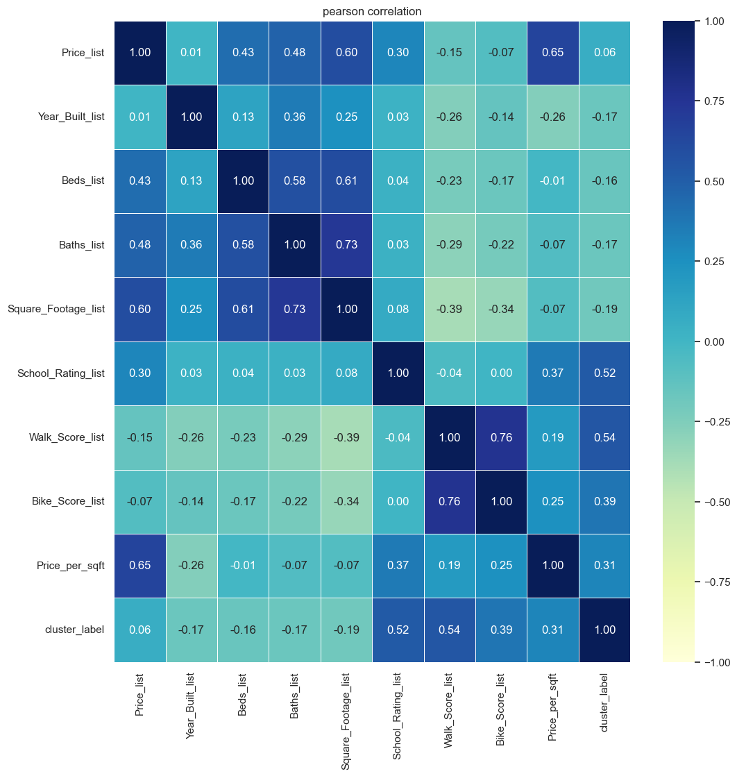

Slide 23
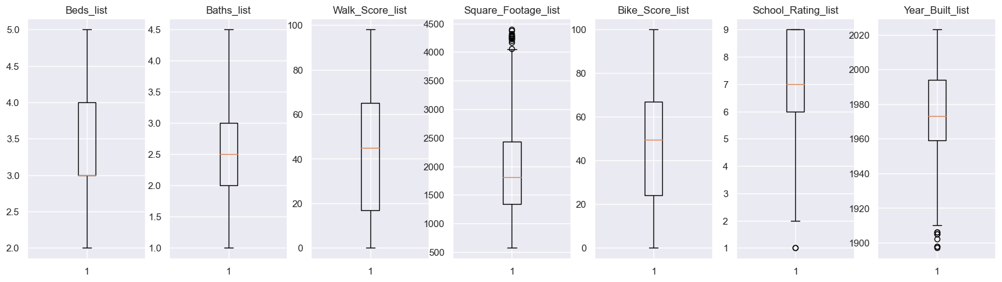

Slide 24
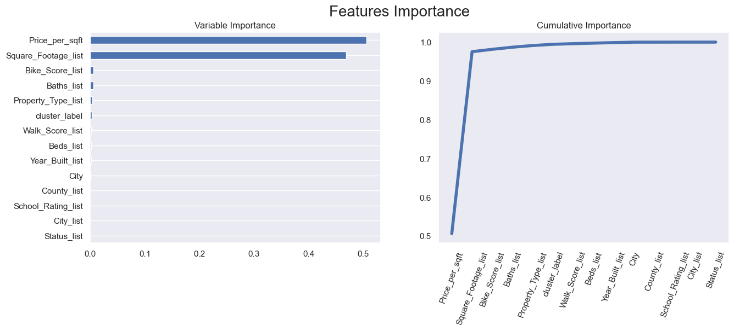

Slide 25
Linear Regression and Random Forest
K-fold validation is performed for two machine learning models, LinearRegression and RandomForestRegressor, to evaluate their performance and plot the predicted vs true and predicted vs residuals.
Residuals distribution is plotted to check for normality.

Slide 26
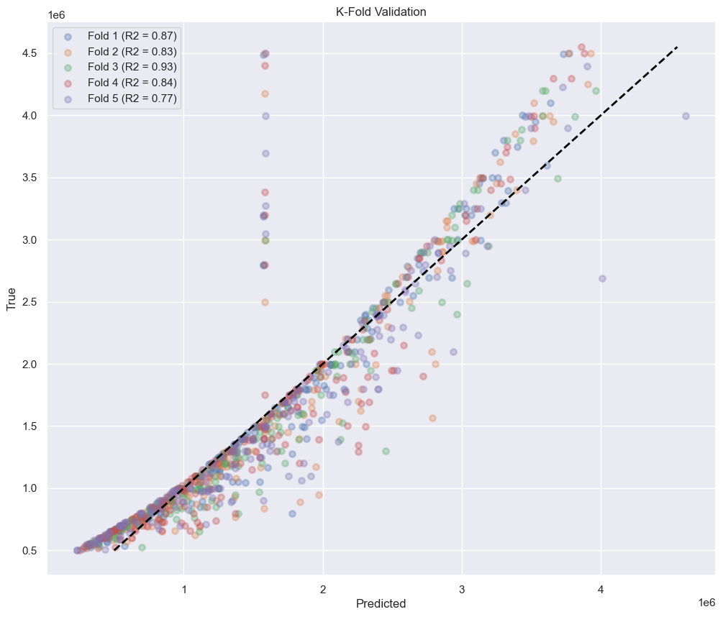
Linear Regression
Based on the R2 scores for each fold of the K-fold cross-validation, this model achieved relatively high R2 scores for each fold, indicating a good fit to the data.

Slide 27
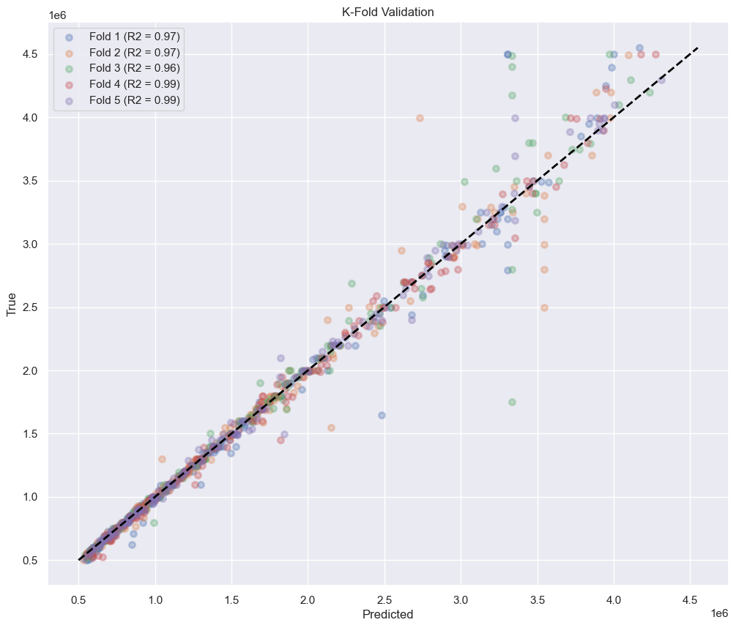
Random Forest
Random Forest model performs well compared to linear regression model based on the R2 scores for each fold in the 5-fold cross-validation

Slide 28
THANK YOU
PRESENTED BY
Adeel Bhaksh
Ashish Tammana
Gerelt
Meak Huang
Swathi Bommina
Yashvanth Shivapura PrabhuDeva

